Slide 1


WFIRST DARK ENERGY
Shoubaneh Hemmati for the WFIRST HLS team
Caltech/ IPAC

Slide 2
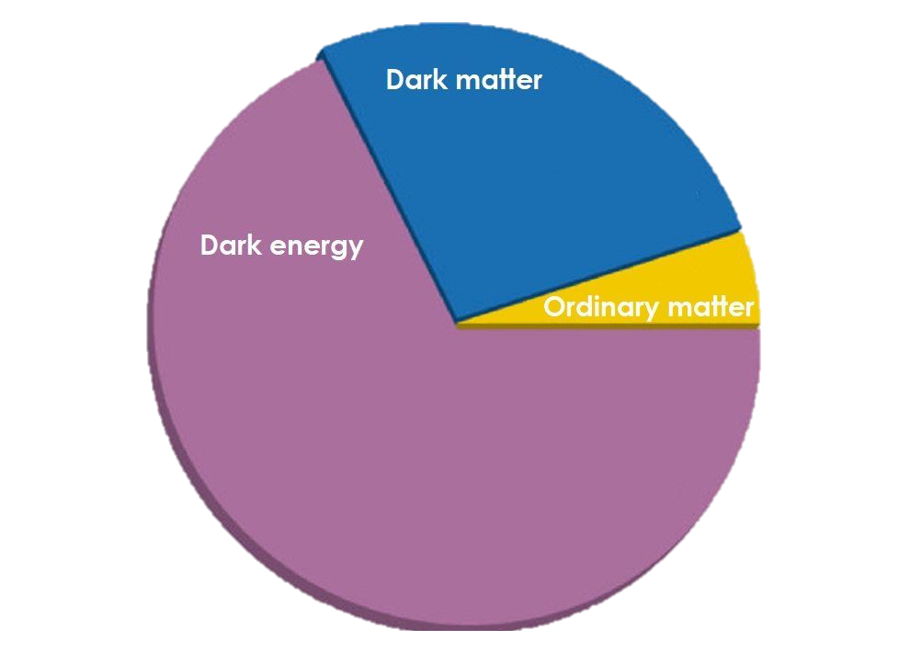
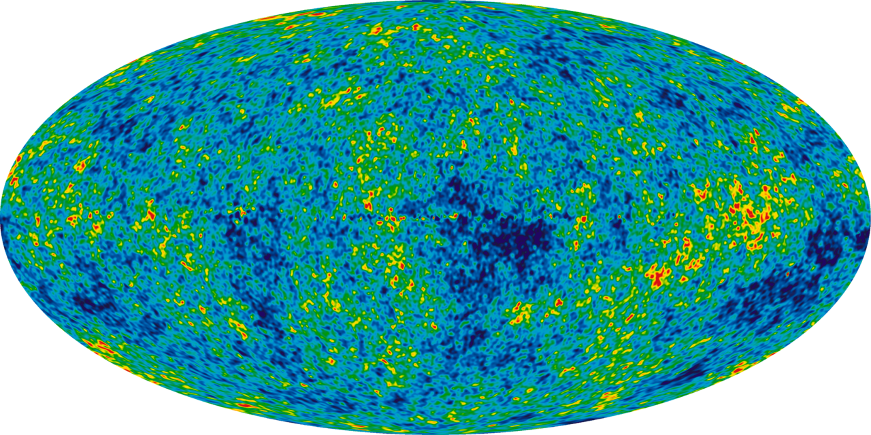
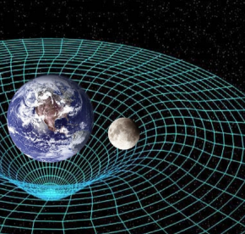
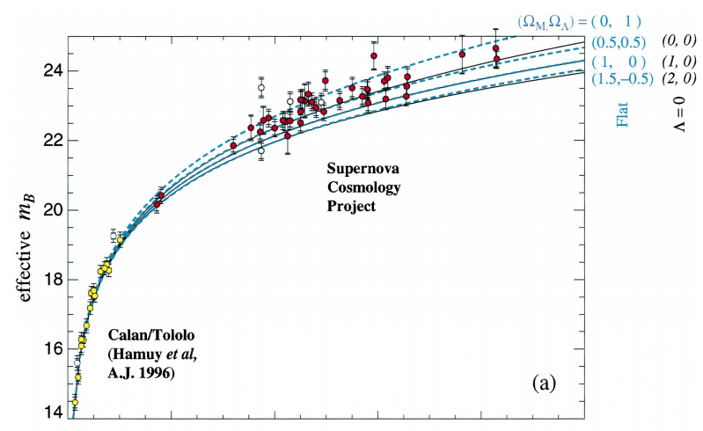
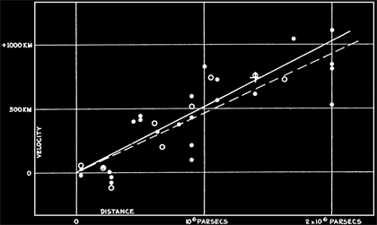
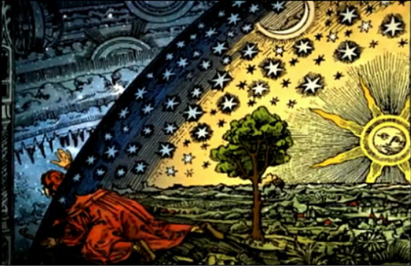
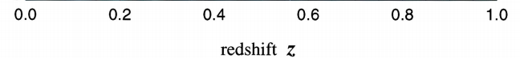
A Glance At History
Expanding Universe,
$Λ$ Greatest Blunder?
Expanding Universe,
Λ Greatest Blunder?
Accelerated Expansion
$Λ$ again …
Accelerated Expansion
Λ again …
General Relativity + $Λ$
General Relativity + Λ
Dark Energy Experiments
Origin: Big Bang
2020s
1998
1965
1930
1920
Apples falling, Heavens
1600

Slide 3
Accelerating expansion
Evidence for accelerated expansion today:
SN Ia
CMB small angular scales
Baryon acoustic scale in galaxy clustering
Weak Lensing of dark matter clustering
Abundance of massive clusters
Structures in Lya forest
Hubble constant
…
Most fundamental question of our time:
no longer “whether” the expansion is accelerating, but “why”
Either a new energy component (constant, scalar field, …)
Or GR breaks at cosmological scales
To do:
Measurement of the expansion history and structure growth in a wide redshift range to the highest possible precision

Slide 4
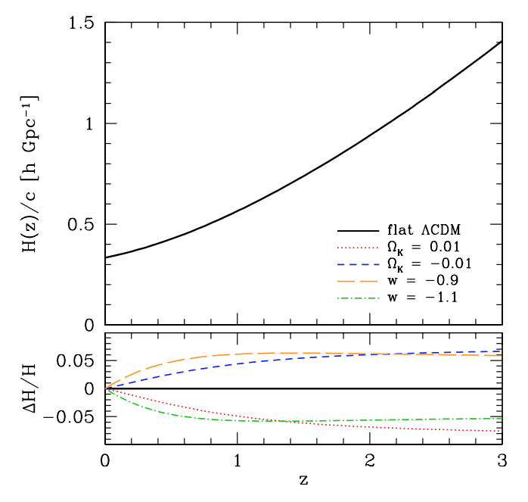
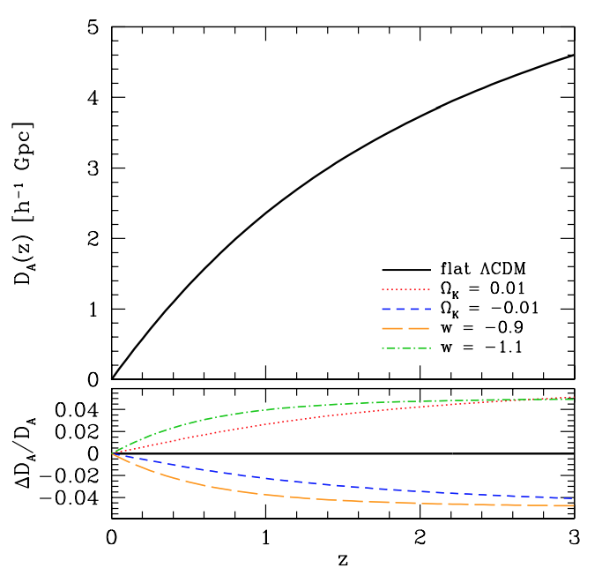
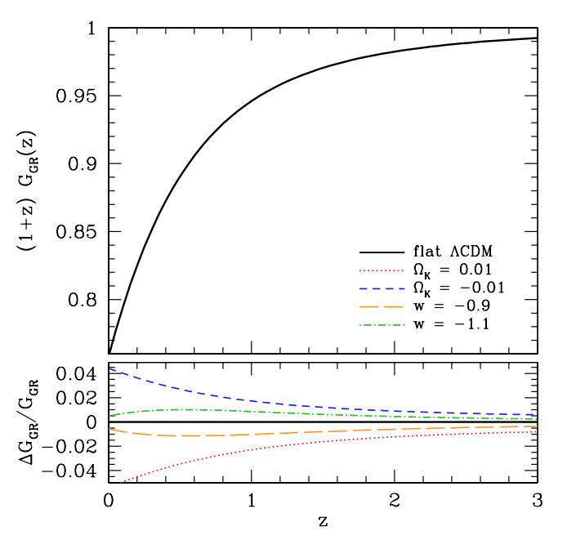

Friedmann eq frames the terms used in Dark Energy Studies
GR Homogenous and isotropic Universe, Friedmann equation:
$$\frac{H^{2}(z)}{H_{0}^{2}}= Ω_{m}{(1+z)}^{3}+Ω_{r}{(1+z)}^{4}+Ω_{k}{(1+z)}^{2}+Ω_{φ}\frac{u_{φ(z)}}{u_{φ(z=0)}}$$
Equation of state of dark energy: $w\left(z\right)= p_{φ}(z)/u_{φ}(z)$
If constant w → $\frac{u_{φ(z)}}{u_{φ(z=0)}}= {(1+z)}^{3(1+w)}$
Generally though: $w\left(a\right)=w_{0}+w_{a}(1+a)$
Observables: H(z), D(z), G(z) → to constrain w(z)
matter
radiation
curvature
Dark energy
Credit: Weinberg 2013

Slide 5
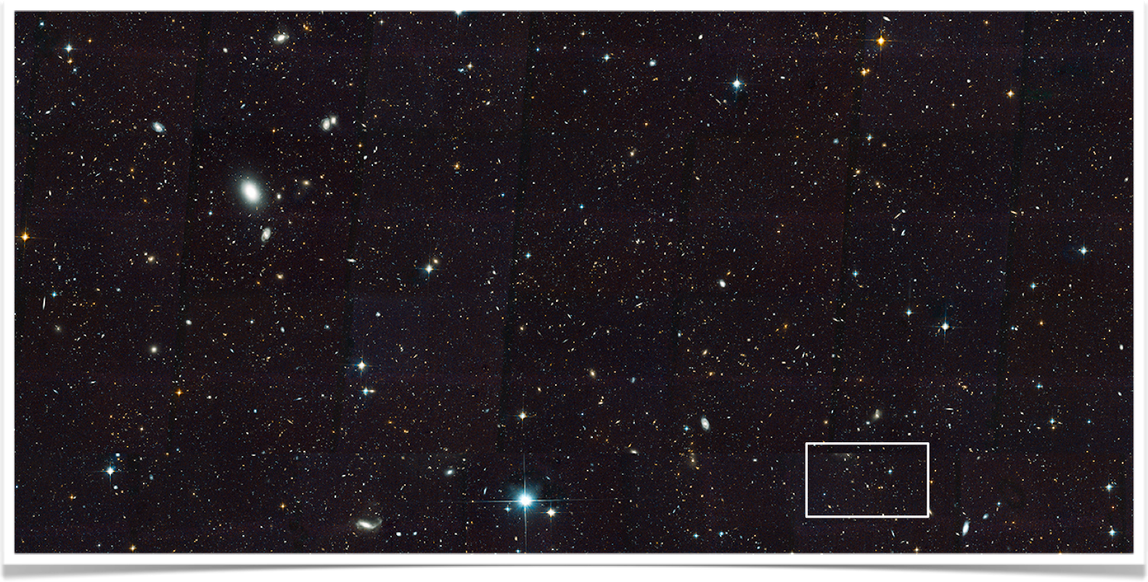
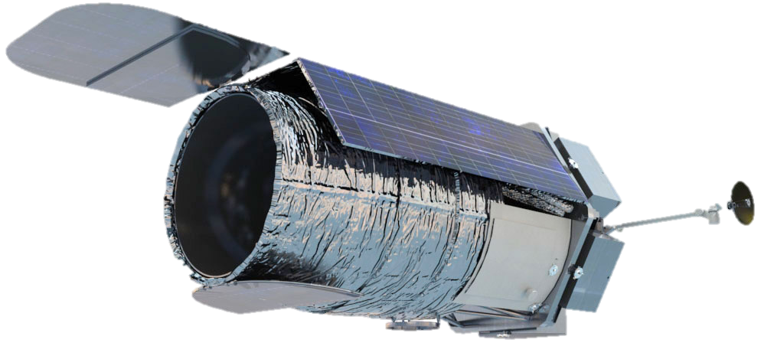
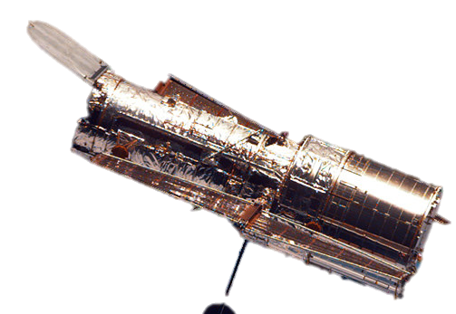
WFIRST
The Wide Field Infrared Survey Telescope
highest ranked large space mission in 2010 decadal Survey
2.4 meter, Hubble quality (0.11 “/pix) on 100x FOV
Visible and NIR: 0.48-2.0 um
Main Goals:
Dark energy
Exoplanets
NIR Survey

Slide 6
WFIRST Probes of Dark Energy
Supernova Ia
Weak Gravitational Lensing
Clustering (BAO)
Balanced combination of probes:
To cross-check systematic uncertainties
To take advantage of complimentary information
redshift

Slide 7
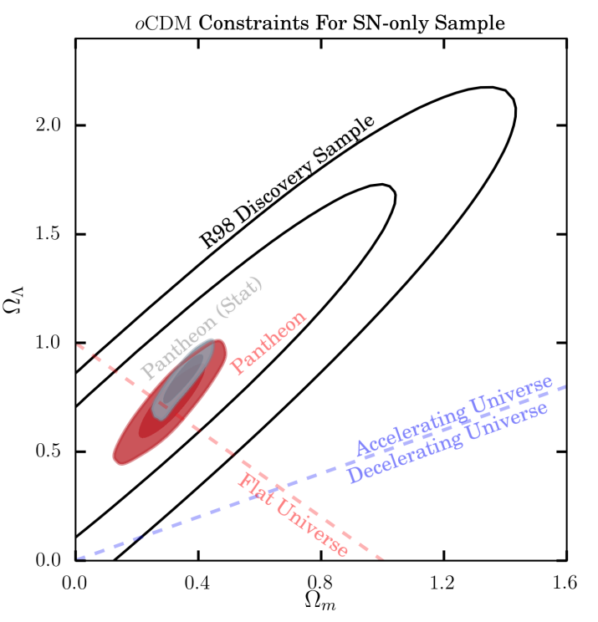
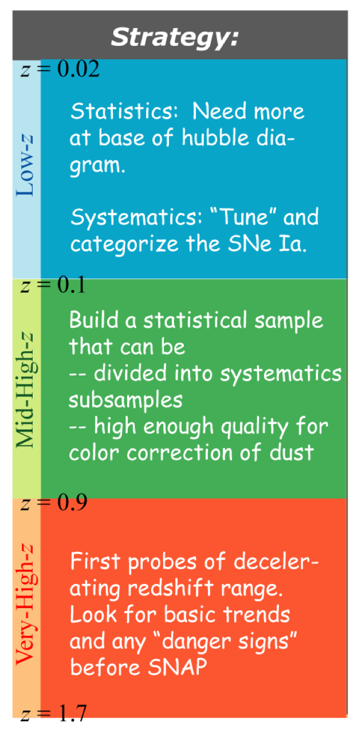
Supernova Type Ia
peak luminosity tightly correlated with light curve, standard candles for measuring distances.
Measures the expansion history through the distance-redshift relation D(z)
Space offers: sharper PSF for fainter SN, more accurate flux calibration, low sky background in NIR
Limited by photometric calibration, dust extinction, and evolution of SN population, not statistical errors
WFIRST will observe:
Wide, medium, & deep imaging+ IFU spectroscopy
2700 SNIa 0.1<z<1.7 → D(z) to ~0.3%
Credit: Scolnic 2018
Credit: Perlmutter

Slide 8
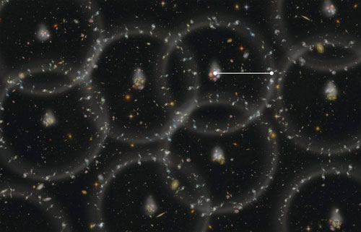
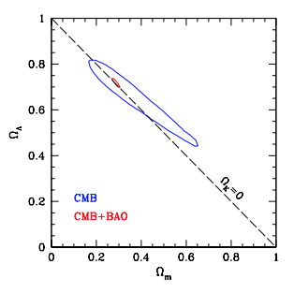
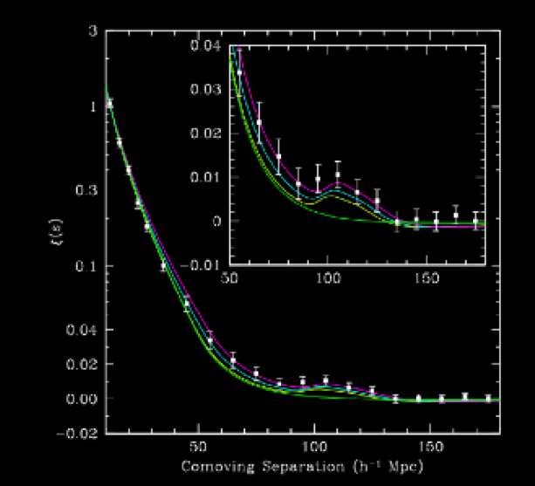
Baryon Acoustic Oscillation
Standard Ruler:
Sound waves propagating before recombination imprint a characteristic scale on matter clustering.
sound horizon today (using clustering of galaxies)
sound horizon at the time of recombination (using the CMB). → D(z), H(z)
w=-1
First detection: (Eisenstein et al. 2005)
40,000 red SDSS spectroscopic galaxies 0.15<z<0.4
WMAP
WFIRST will measure: D(z) H(z)
16 million Ha at 1<z<2 0.5% 0.9%
1.4 million [OIII] at 2<z<3 1.3% 2.1%

Slide 9
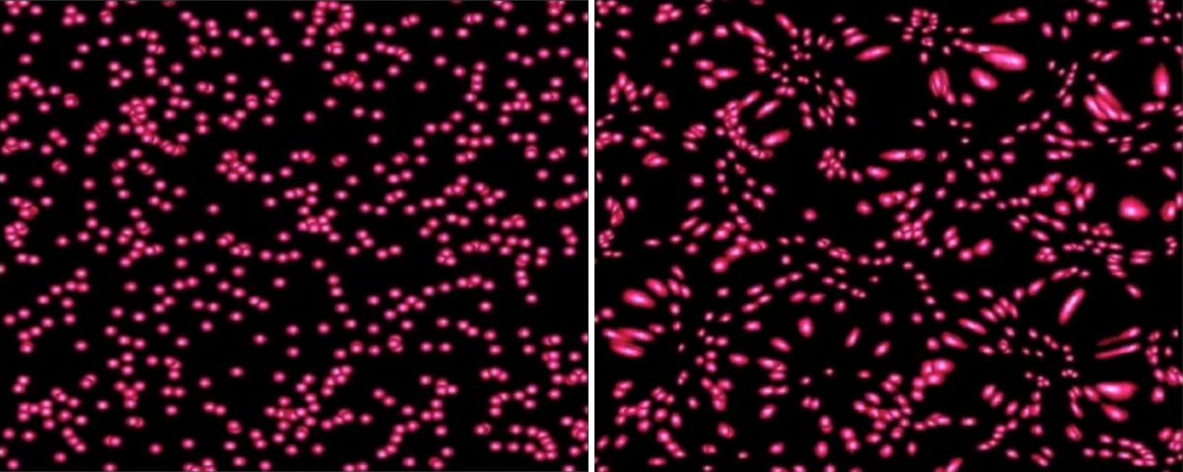
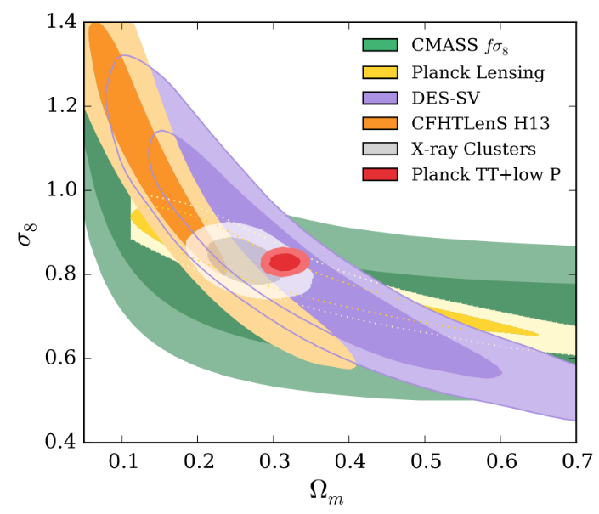
Weak Gravitational Lensing
Correlation of ellipticities as a function of angular separation averaged over many galaxy pairs→
weak lensing small effect (0.5%) on distorting shapes of galaxies → growth function G(z), D(z)
WFIRST will observe:
Imaging (High Latitude Survey)
~2000 sq deg Y,J, H, F184 to ~26.5 AB
380m lensed galaxies
40,000 massive clusters
G(z) → z<1: 0.21% z>1 : 0.78%
Needs very large samples with good shape measurements and precise redshifts

Slide 10
new methodologies within these probes can further improve Cosmological constraints
All of the mentioned probes use statistical samples of galaxies → A better galaxy classification can improve inferences from those samples

Slide 11

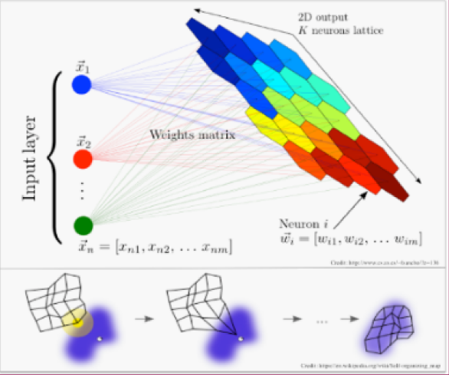
Dimension Reduction, SOM
Unsupervised Neural Network to reduce multi-dimensional data while preserving topology.

Slide 12
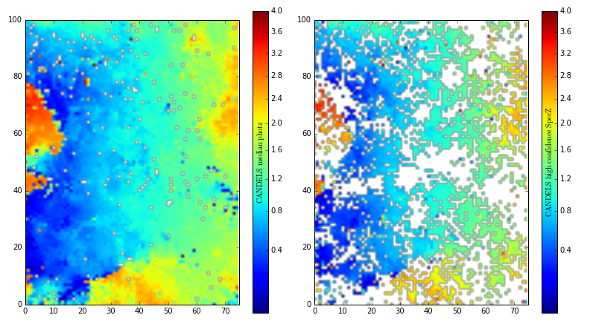
WFIRST WL redshift Calibration
Calibrating photometric redshifts to accuracy needed for WL.
Spectroscopic target selection based on the color-redshift relation
Synthetic analog LSST+WFIRST catalog from CANDELS observations
Hemmati et al. 2018

Slide 13
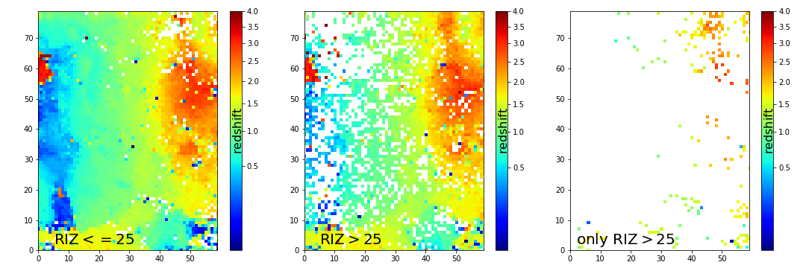
WFIRST vs. EUCLID
26% of WFIRST sample is fainter than Euclid
91% of which live in cells containing a bright source as well.
4% of the SOM cells have no bright galaxy counterpart
Hemmati et al. 2018

Slide 14
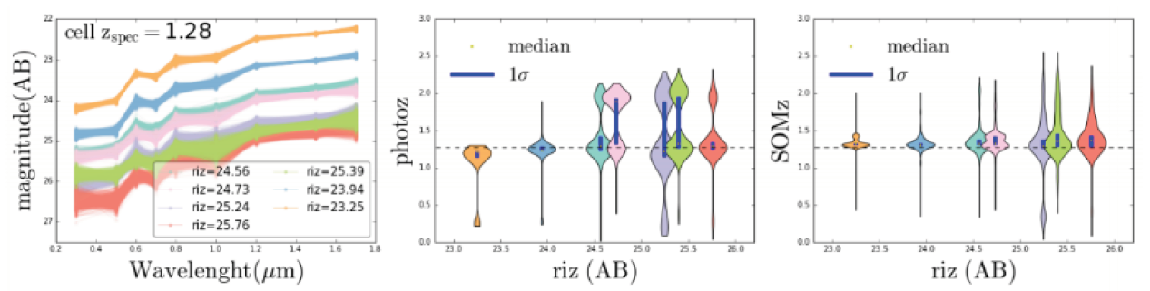
SOM also improves Photometric Redshifts
Hemmati et al. 2018
This will enable even larger sample size available for weak lensing shape measurements

Slide 15
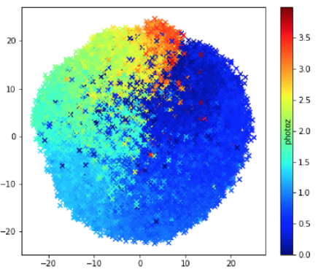
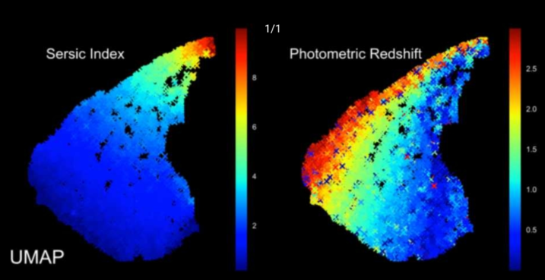
Structural parameters break redshift degeneracies

Slide 16
Thanks.

Slide 17
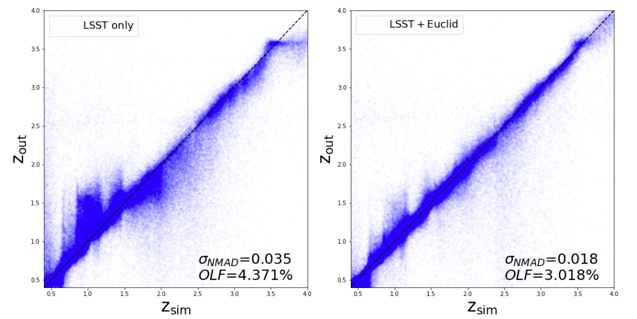
NIR space Data improves OPTICAL Ground-based measurements
Data-driven simulation based on cosmos data
to mimic LSST optical and Euclid space data.
Redshifts are measured using LePhare SEDfitting code.
Better photometric redshifts, when NIR data is added.
Rhodes et al. 2017

Slide 18
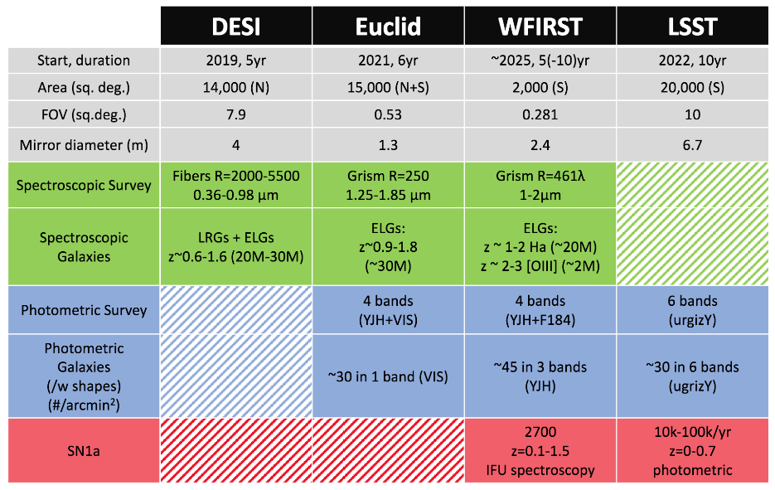
Extra- Some comparisons

